Slide 1


Notes:
In 2002 Spring, when I took the Advanced Computer Networks class under Dr. Ramamurthy. Learned OPNET
When it comes to project 1, most COMP3500 students like to follow the Nike creed: Just do it!
When you follow a list of instructions, you should focus on the meaning of each command.

Slide 2


Notes:
When it comes to project 1, most COMP3500 students like to follow the Nike creed: Just do it!
When you follow a list of instructions, you should focus on the meaning of each command.

Slide 3
Test Your Skills

Slide 4
Exercise 1 (Menti) ⬇⬇⬇⬇
What is the yum command ?
A configuration software tool
A troubleshooting software tool
An automated uninstallation program
A package management program
Notes:
Yellowdog Updater Modified

Slide 5
Exercise 2 (Menti) ⬇⬇
In the gdb debugger, typing character ‘n’ means:
‘next’ - Step into the next function.
‘new’ - Set a new breakpoint
‘next’ - Continue to the next source line
‘new’ – Create a new local variable
Notes:
Yellowdog Updater Modified

Slide 6
Exercise 3 (Menti) ⬇⬇⬇
What does the following command do?
$git remote add origin https://gitlab.eng.auburn.edu/usr_name/os161.git
Create a Git local repository
Add local changes to a remote repository
Creates a new remote repository called origin
Commit stages files to a remote repository called origin
Notes:
Git

Slide 7
Exercise 4 (Menti) ⬇
What does the following command do? (project1 is a subdirectory in directory projects
%cd ~/projects
%tar vfzc project1.tgz project1
Create a single compressed file for project1
Uncompress files for project1
Validate files of project1
Install files of project1
Notes:
tar

Slide 8
Exercise 5 (Menti) ⬇
What is the chmod command in Linux?
changes a file’s name.
changes a file’s permissions.
changes the number of cores
changes a file’s module.
Notes:
Yellowdog Updater Modified

Slide 9
Exercise 6 (Menti) ⬇
Which one of the following commands allows you to know your Linux machine's processor information?
$cat cpu_info
$more cpu_info
$more /proc/cpu
$more /proc/cpuinfo
Notes:
Yellowdog Updater Modified

Slide 10
The “bfd” error when install
cs161-binutils-1.5
You must setup CFLAGS:
export CFLAGS="-g -O2 -Wno-error"

Slide 11
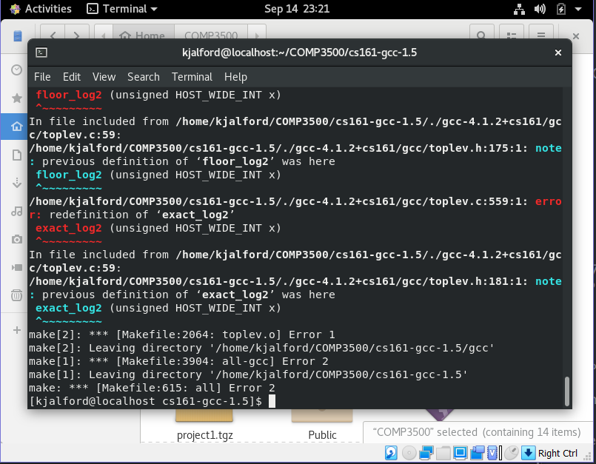
You must setup CFLAGS:
export CFLAGS="-std=gnu89 -g -O2 -Wno-error"

Slide 12
What’s Expected (binutils)?

Slide 13
What’s Expected (cs161-gcc)?

Slide 14
What’s Expected (cs161-gdb)?

Slide 15
Don’t Forget sys161.conf
Canvas->Files->Projects->OS161
place sys161.conf in ~/cs161/root

Slide 16
Attention!
Please note that missing package in CentOS may cause the installation errors. Please try the following command to install the missing package prior to the tool installations.
yum install ncurses-devel

Slide 17
Why ncurses-devel?
Problem without ncurses-devel: While trying to configure the cs161-gdb for Project 2, I am encountering a build error: "no termcap library found".
Solution: yum install ncurses-devel

Slide 18
Cs161-gdb Build Errors
Solution: Set up the compilation flag variable CFLAGS.
Step 1: extract the special gdb tarball
Step 2: $export CFLAGS="-g -O2 -Wno-error"
Step 3. run the toolbuild.sh script
Notes:
Don’t treat warning messages as errors in gdb.
This problem can be fixed by setting up the compilation flag variable CFLAGS. Please follow the three steps below:
Step 1: extract the special gdb tarball
Step 2: $export CFLAGS="-g -O2 -Wno-error"
Step 3. run the toolbuild.sh script

Slide 19
Cs161-gdb Build Errors (cont.)
Problem: We changed CFLAGS, but we got an error that we've changed CFLAGS and it quits after that.
Solution: After you change CFLAGS, you must delete all of the config.cache files and rebuild everything.
Step 1: cd ~/cs161
Step 2: rm -f ./*/config.cache
Step 3: rm -f ./*/*/config.cache
Once you finish the three steps, you must rebuild everything.
Notes:
After you change CFLAGS, you must delete all of the config.cache files and rebuild everything. To delete the config.cache files, please carry out the following steps:
Step 1: cd ~/cs161
Step 2: rm -f ./*/config.cache
Step 3: rm -f ./*/*/config.cache
Once you finish the above steps, you should rebuild everything in order.

Slide 20
Compilation Errors
Problem: When I try to run make depend to make the kernel, I get the following error:
/bin/sh: cs161-gcc: command not found make: *** [depend] Error 127
Solution: Use ‘echo $PATH’ to check your $PATH.
export PATH=~/cs161/bin:$PATH
You may need to add that statement to your .bashrc file.

Slide 21
COMP 3500 Introduction to Operating Systems Project 2 – Modifying OS/161
Dr. Xiao Qin
Auburn University http://www.eng.auburn.edu/~xqin
xqin@auburn.edu
Notes:
New schedule in Spring 2017.
Fall’16: Should give this lecture on Lec03a or Lec03b.

Slide 22
Modifying your kernel
Create a new file
~/cs161/src/kern/main/hello.c
Edit ~/cs161/src/kern/main/main.c
which calls the hello function
Before reconfiguring and rebuilding your kernel, you will need to edit
~/cs161/src/kern/conf/conf.kern

Slide 23
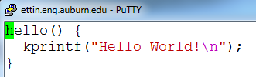
Your hello.c

Slide 24
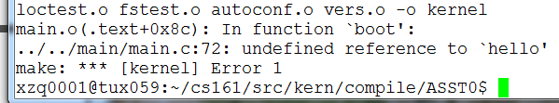
A Compilation Error

Slide 25
Edit kern/conf/conf.kern
cd ~/cs161/src/kern/conf
vi conf.kern
/main.c #search main.c in conf.kern see also line 374
Add the following line:
file main/hello.c

Slide 26
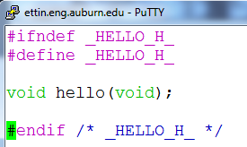
Create a header file: hello.h

Slide 27
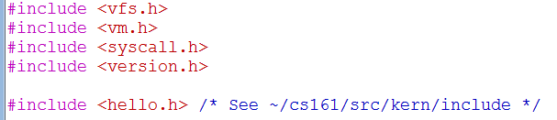
Add #include <hello.h> into main.c

Slide 28
Configure your source code tree
cd ~/cs161/src
./configure
Why this is important?
cd ~/cs161/src/kern/conf
./config ASST0
When should you reconfigure OS161?
Notes:
Answer: Prepare makefile
Answer: add new files. Want to automatically update makefile.

Slide 29
Build the ASST0 kernel.
cd ../compile/ASST0
make depend
make
make install
Why this is important?
Notes:
Answer: move the executable kernel into cs161/root

Slide 30
Build the user level utilties
cd ~/cs161/src
make
Run OS161
cd ~/cs161/root
./sys161 kernel
Notes:
Answer: move the executable kernel into cs161/root

Slide 31
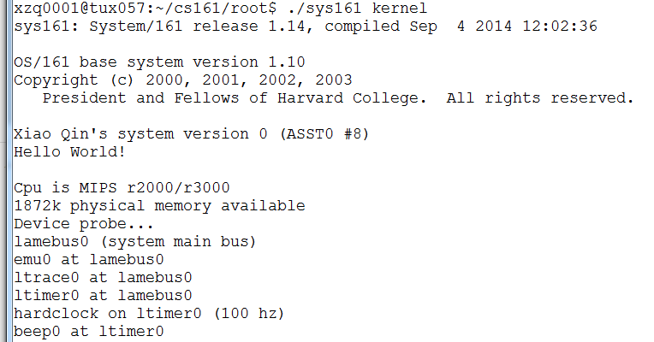
What do you expect?
Notes:
Answer: move the executable kernel into cs161/root

Slide 32
Exercise 7 (Menti) ⬇⬇⬇⬇
How to fix the following problem when you run os161?
$./sys161 kernel
sys161: Cannot open config file sys161.conf
Must set up $PATH using the export command
Must set up $CFLAGS using the export command
Must copy sys161.conf in the /cs161/root directory
Must copy sys161.conf in the /cs161/bin directory
Notes:
Yellowdog Updater Modified

Slide 33
Exercise 8 (Menti) ⬇⬇⬇⬇
How to fix the following problem when you try to build the os161 kernel using “make depend”
$/bin/sh: cs161-gcc: command not found make: *** [depend] Error 127
cp sys161.conf ~/cs161/bin
$export CFLAGS="-g -O2 -Wno-error"
$export PATH=~/cs161/bin:$PATH
rm -f ./*/config.cache
Notes:
Yellowdog Updater Modified

